Slide 1



Code, Commit, Secure
DEVSECOPS IN ACTION
Michael Tayo
/michaeltayo
Notes:
Welcome everyone to "Code, Commit, Secure: DevSecOps in Action."
Today, we'll explore how to integrate security seamlessly into your development process.
I'm Michael Tayo and I'm excited to share insights and real-world examples of DevSecOps.
Let's dive in!

Slide 2



About
B.S. Information Technology, Marquette University M.S Information Security & Assurance, Strayer University
Principal Security Engineer, U.S. Bank, AVP, Cloud and Application Security - Enterprise Security Architecture
Research: Cloud Security, DevSecOps, Cyber Fusion, Security Operations, Automation, Leadership and Product Management
Author: Anomali - Collaborative Security to Defend the Modern Landscape
Hobbies: Traveling, Music Concerts, Playing Sports
Michael Tayo
/michaeltayo
Notes:
Here's a little bit about me and my background.
I have been in IT and Cybersecurity for about 10 years.
Hold multiple degrees.
Currently at USB, previously, Tempus AI (biotech startup), Sirius/Forsythe (Acquired by CDW)
Published author, google me lol
In my free time,I enjoying travel, concerts and sports.
Let's dive in!

Slide 3

Disclaimer
The opinions expressed in this presentation are my own and do not necessarily reflect the opinions of my employer or any other organization.
This presentation is for educational purposes only.
I am not affiliated with any of the products or services mentioned in this presentation, and I have not been paid to endorse any of them.
All tools and resources shown in this presentation are for reference purposes only.
I encourage you to do your own research before making any decisions.
Notes:
A quick disclaimer: the information provided is for educational purposes.
Results may vary based on your specific implementation.
Always consult with security professionals for tailored advice.

Slide 4



Objectives & Key takeaways:
Comprehensive Understanding of DevSecOps
Practical Demonstrations and Real-World Examples
Actionable Best Practices
Notes:
This presentation is a comprehensive guide to DevSecOps.
We'll explore key principles, best practices, and real-world examples.
Our goal is to empower you to build secure, resilient software.
Our objectives today are to understand DevSecOps principles, learn about its benefits and importance, explore real-world case studies, and gain actionable tips for implementation.
Let's get started!

Slide 5

1.
3.
Introduction to DevSecOps
DevSecOps Case Studies & Tools, & Techniques
2.
4.
Key Principles of DevSecOps
Best Practices for Implementing DevSecOps
Table of contents
Notes:
Here’s our agenda for today:
Introduction
Key Principles
Case Studies
Tools and Techniques
Implementation Tips
Summary

Slide 6


DevSecOps Statistics
Increase in Security Automation
Improved Security Posture
62% of organizations reported using automated security tools within their DevOps pipelines, up from 30% in 2018
- Puppet 2021
Organizations that have fully integrated DevSecOps practices experience 50% fewer security breaches and can remediate vulnerabilities 90% faster compared to those with minimal integration
- Sonotype 2021
Notes:
Let's look at some statistics:
In a 2021 survey conducted by Puppet
- 62% Organizations reports using devsecops in their pipeline- up 30 % from 2018
Showcase, this is slowly becoming the new norm in larger enterprises.
Also in 2021 , sonotype ran a survey that showcases that those orgs that fully inmpelemtned devsecops saw 50% security breaches and remediated vulnerabilities faster
It works...

Slide 7
What’s the DevSecOps Mission?
... creating targeted customer value through secure iterative innovation at speed & scale.
Notes:
The mission of DevSecOps is to
create value fast without diminishing quality or security posture.
Keywords, value, innovation, speed

Slide 8



It is a practice that integrates security measures into every stage of the software development lifecycle (SDLC), from initial design through to deployment and beyond.
What is DevSecOps?
Think of DevSecOps as a way to make sure that the code developers write is secure right from the start, rather than adding security checks at the end.
Development, Security, & Operations
Notes:
DevSecOps stands for Development, Security, and Operations.
It integrates security at every stage of development.
This ensures robust, secure, and compliant software.

Slide 9





Early Detection of Vulnerabilities
Speed and Efficiency
Cost-Effective
Importance in Today's Software Development
Enhanced Collaboration
Regulatory Compliance
Notes:
Importance in Today's Software Development:
Early Detection of Vulnerabilities: Integrating security early helps identify and fix vulnerabilities as they arise, rather than after the fact.
Speed and Efficiency: Continuous security practices enable faster, more secure software releases, reducing time-to-market.
Cost-Effective: Addressing security issues early in the development process is significantly less costly than post-deployment fixes.
Enhanced Collaboration: Encourages a culture of shared responsibility among development, security, and operations teams.
Regulatory Compliance: Ensures ongoing adherence to industry standards and regulatory requirements, avoiding costly penalties and enhancing reputation.

Slide 10




Shift Left Security
Automation
Collaboration
Key Principles of DevSecOps
Continuous Monitoring
Immutable Infrastructure
Notes:
Key principles of DevSecOps:
Shift Left Security: Integrate security early, like static code analysis during coding.
Automation: Use tools like CI/CD pipelines for continuous testing.
Collaboration: Foster teamwork between development, security, and operations.
Continuous Monitoring: Use tools for ongoing assessment, like AWS GuardDuty.
Immutable Infrastructure:
Deploy consistent environments using Docker or Kubernetes.

Slide 11
Traditional Development vs. DevSecOps
Aspect | Traditional Development | DevSecOps
Security Integration | Late in SDLC | Early and continuous
Responsibility | Separate security team | Shared responsibility
Vulnerability Detection | Late-stage or post-deployment | Early and continuous
Development Speed | Slower due to late-stage fixes | Faster due to early issue resolution
Notes:
Traditional: Security is integrated late, leading to higher costs and slower fixes.
DevSecOps: Security is early and continuous, fostering collaboration and faster issue resolution.

Slide 12
Traditional Development vs. DevSecOps (cont’d)
Aspect | Traditional Development | DevSecOps
Cost of Fixing Issues | High due to complexity of late fixes | Lower, issues fixed early
Collaboration | Limited interaction | Close collaboration
Compliance | Periodic and manual | Continuous and automated
Tool Usage | Separate tools, minimal integration | Integrated toolchain, automation
Notes:
Let's compare traditional development with DevSecOps.
Traditional development integrates security late, leading to late-stage vulnerability detection and high fixing costs.
DevSecOps integrates security early, ensuring continuous detection and lower costs.
It fosters collaboration, and continuous compliance, and uses integrated tools.

Slide 13
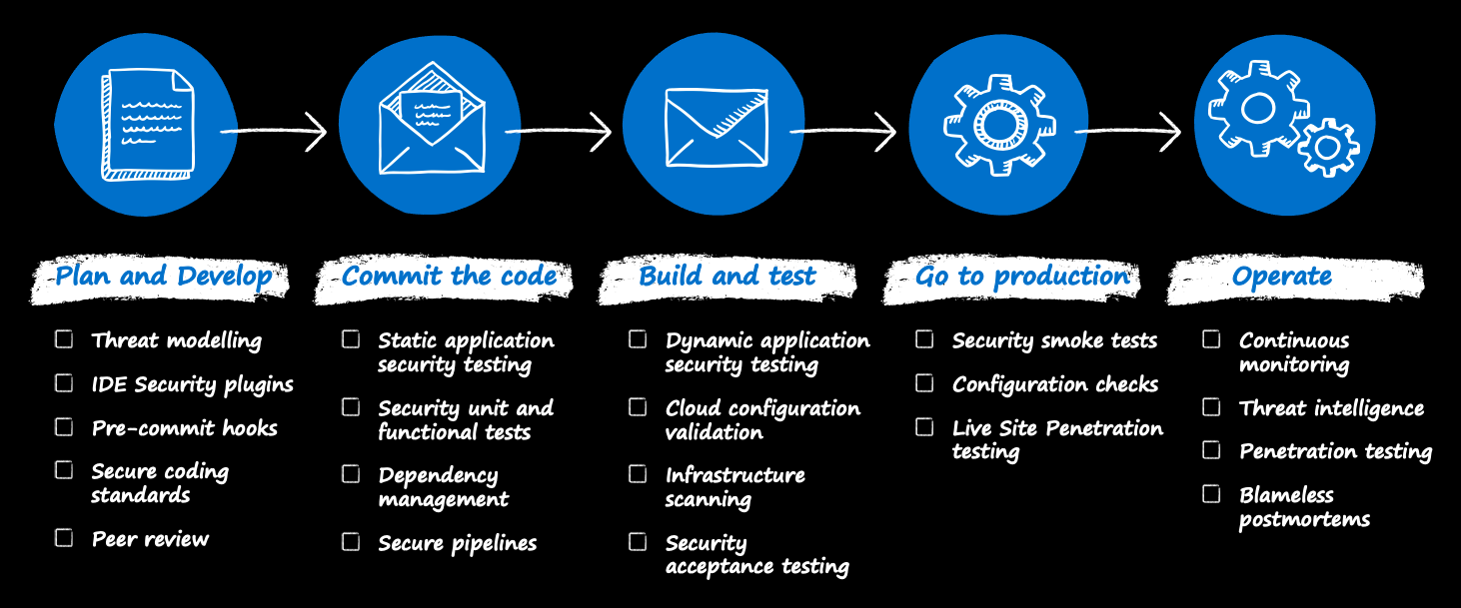
DevSecOps
Source: Microsoft

Slide 14
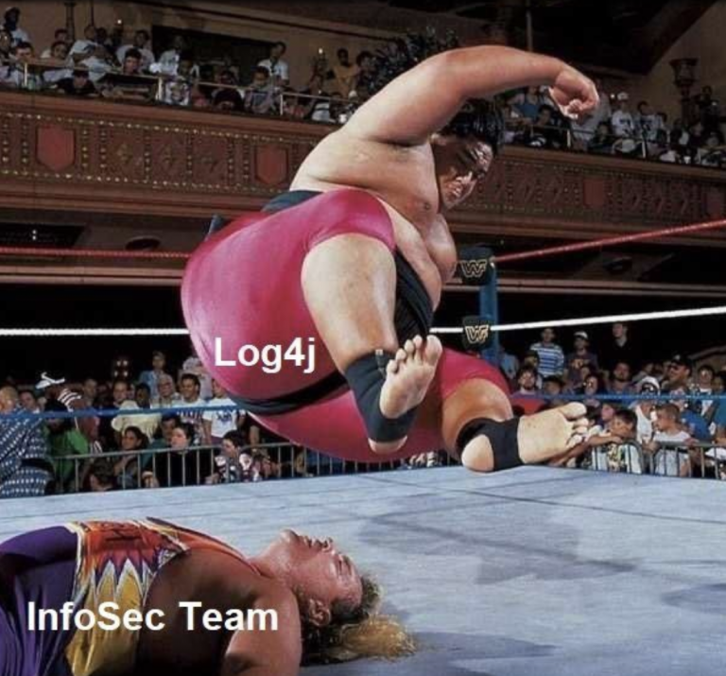
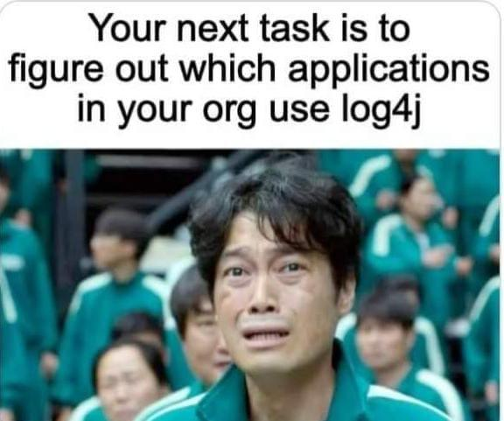
Remember this...

Slide 15



Common Security Risks in DevOps
DEPENDENCY MANAGEMENT
STATIC ANALYSIS
Manual code reviews can miss critical security vulnerabilities in the source code.
Reliance on outdated or vulnerable third-party libraries can introduce security flaws.
DYNAMIC ANALYSIS
INFRASTRUCTURE AS CODE
Security vulnerabilities may go unnoticed until after deployment, posing significant risks.
Inconsistent or insecure infrastructure configurations can lead to vulnerabilities.
Notes:
Dependency Management
Traditional DevOps Risk: Reliance on outdated or vulnerable third-party libraries can introduce security flaws.
DevSecOps Solution: Automated dependency management tools scan for and update insecure dependencies to ensure secure and up-to-date components.
Static Analysis
Traditional DevOps Risk: Manual code reviews can miss critical security vulnerabilities in the source code.
DevSecOps Solution: Automated static code analysis tools continuously scan for security issues in code before it is integrated, ensuring early detection and remediation.
Dynamic Analysis
Traditional DevOps Risk: Security vulnerabilities may go unnoticed until after deployment, posing significant risks.
DevSecOps Solution: Dynamic analysis tools perform real-time testing on running applications to identify and fix security flaws before they reach production.
Infrastructure as Code (IaC)
Traditional DevOps Risk: Inconsistent or insecure infrastructure configurations can lead to vulnerabilities.
DevSecOps Solution: IaC practices ensure that infrastructure is versioned, reviewed, and tested for security issues, promoting consistent and secure deployments.

Slide 16




Common Security Risks in DevOps (cont’d)
BUILD PIPELINES
ACCESS CONTROL
Security checks are often manual and separate from the build process, leading to overlooked vulnerabilities.
Inadequate access controls can lead to unauthorized access and data breaches.
DOCUMENTATION
ARTIFACT SIGNING
Poor or outdated documentation can lead to insecure development practices and configurations.
Unsigned artifacts can be tampered with, leading to security breaches.
Notes:
Build Pipelines/Systems
Traditional DevOps Risk: Security checks are often manual and separate from the build process, leading to overlooked vulnerabilities.
DevSecOps Solution: Integrating security tools into automated build pipelines ensures continuous security testing and faster feedback loops.
Access Controls
Traditional DevOps Risk: Inadequate access controls can lead to unauthorized access and data breaches.
DevSecOps Solution: Implementing strict, role-based access controls (RBAC) and continuous monitoring helps protect sensitive data and systems from unauthorized access.
Documentation
Traditional DevOps Risk: Poor or outdated documentation can lead to insecure development practices and configurations.
DevSecOps Solution: Comprehensive, up-to-date documentation ensures that security practices and configurations are clearly defined and consistently followed.
Artifact Signing
Traditional DevOps Risk: Unsigned artifacts can be tampered with, leading to security breaches.
DevSecOps Solution: Artifact signing ensures the integrity and authenticity of code and dependencies, preventing tampering and ensuring secure deployments.

Slide 17

The Problem
Addressing security as an afterthought or out of cycle activity created inefficiencies and additional risk
Case Study
The Centers for Medicare & Medicaid Services (CMS)
Notes:
Background: A large-scale federal agency.
Challenge: Needed secure, compliant software releases.

Slide 18

The Proposed Solution
Implement a security automation framework (SAF) into code pipelines.
Infrastructure - creates the ability to destroy and re-create
Code - enforces continuous security and quality checks with every code commit
Security – provides configuration and vulnerability checks.
Case Study
The Centers for Medicare & Medicaid Services (CMS)
Notes:
Solution: Implemented DevSecOps.

Slide 19

The Results
Hardened operating system as a result of automation
Reduced burden of security assessments
Continual improvement of the security posture
Increased product quality
Accelerated software integration and deployment with precision
Ability to validate configuration on demand
Ability to automate product reconstruction for disaster recovery
On-demand for testing and feature rollouts
Case Study
The Centers for Medicare & Medicaid Services (CMS)
Notes:
Outcome: Enhanced security posture and faster release cycles.
Rapidly produce secure software, but also demonstrate a secure software approach to our product owners, users, and other stakeholders.

Slide 20
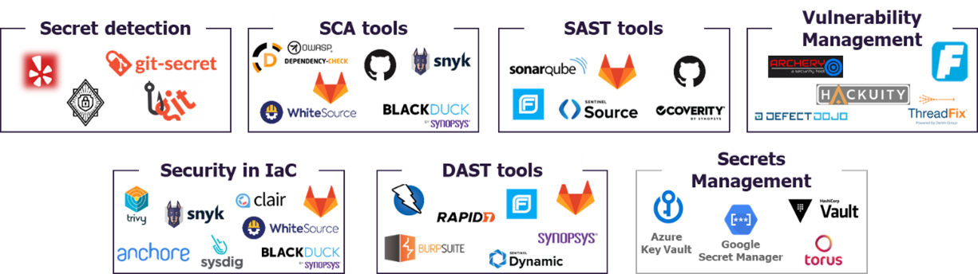
The DevSecOps Tool Marketplace
Remember: DevSecOps = Methodology
Notes:
The DevSecOps tool marketplace includes various categories:
Code Analysis: Snyk, SonarQube.
Monitoring: Prometheus, Splunk.
CI/CD: Jenkins, GitLab CI.
Container Security: Docker Security, Kubernetes Security.

Slide 21
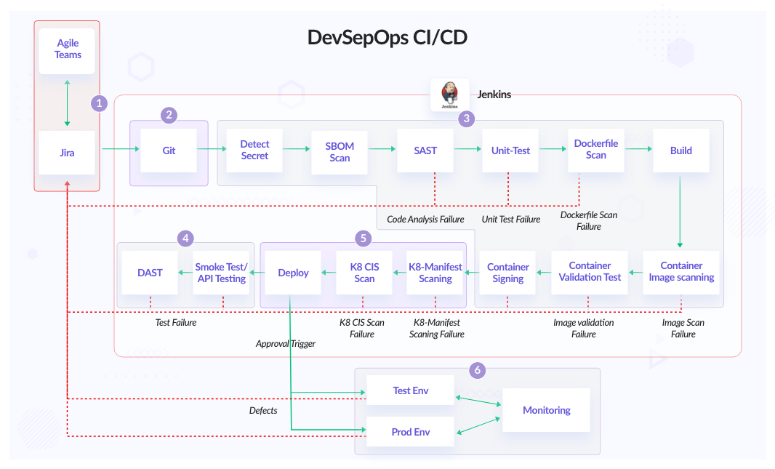
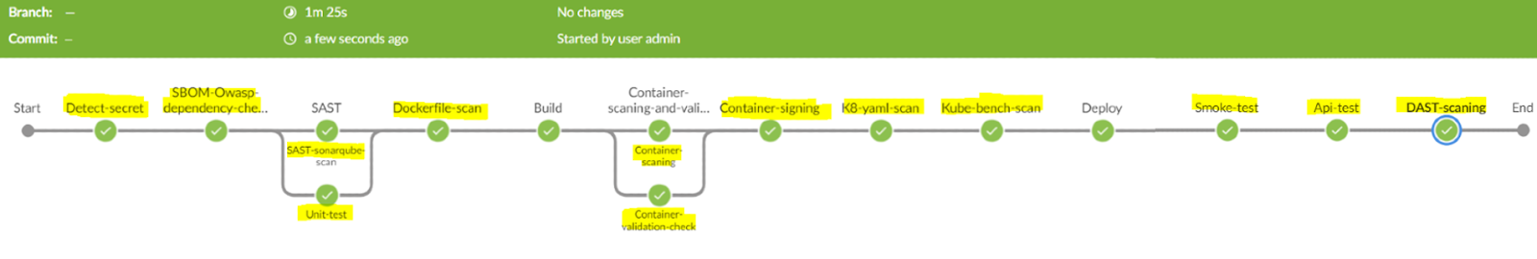
Enterprise DevSecOps Pipeline Example
Source: InfraCloud
Notes:
Example of an enterprise DevSecOps pipeline:
Stages: Plan, Code, Build, Test, Release, Deploy, Operate, Monitor.
Tools: Jira for planning, Git for coding, Jenkins for building, Selenium for testing, Docker for deploying, Kubernetes for operating, Prometheus for monitoring.

Slide 22
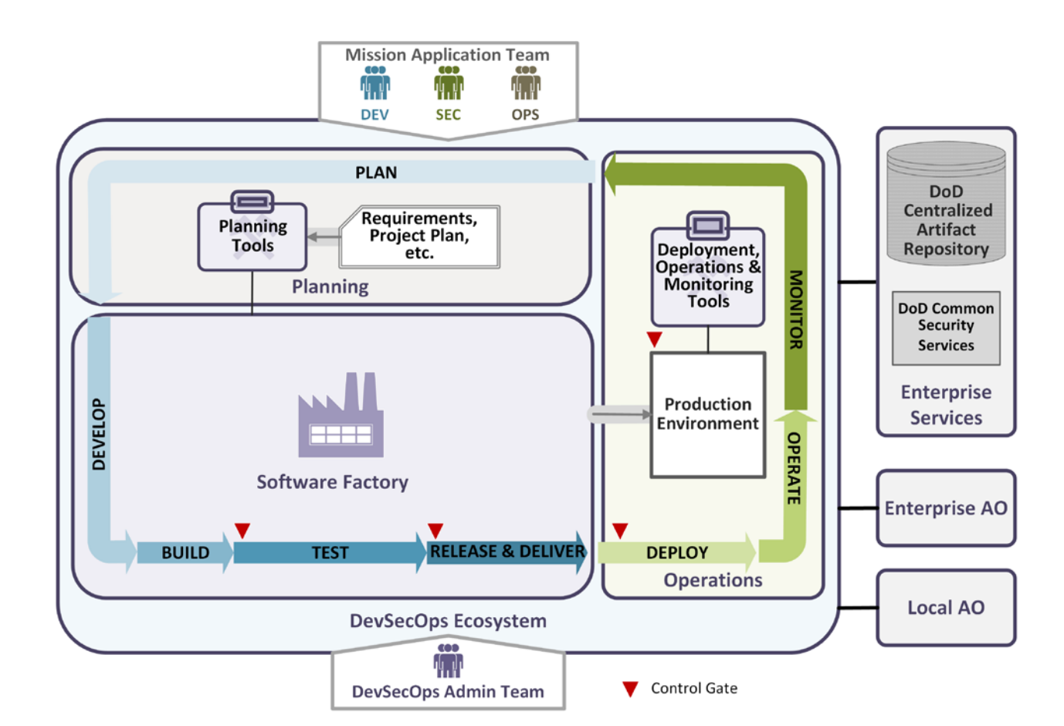
DevSecOps Ecosystem
Source: DoD Enterprise DevSecOps Reference Design
Notes:
The DevSecOps ecosystem includes:
Components: People, processes, and tools.
Integration: Ensures seamless collaboration between development, security, and operations.

Slide 23









Open Source DevSecOps Pipeline
Source: Michael Tayo (LinkedIn)
Jenkins - Pipeline
Github - Source Code Manager
TruffleHog - Secrets Scanner (docker)
owasp/dependency-check - Software Composition Analysis (SCA)(bash script)
Sonarqube - SAST (docker container)
Maven - Build ( running on instance)
Tomcat - Web HTTP server that runs Java code (running on instance)
Zap - DAST (running on docker)
Notes:
Open source DevSecOps pipeline tools include:
OWASP ZAP for security testing.
Clair and Trivy for container security.
GitLab CI/CD for continuous integration and deployment.
Benefits include cost-effectiveness, community support, and customization.

Slide 24
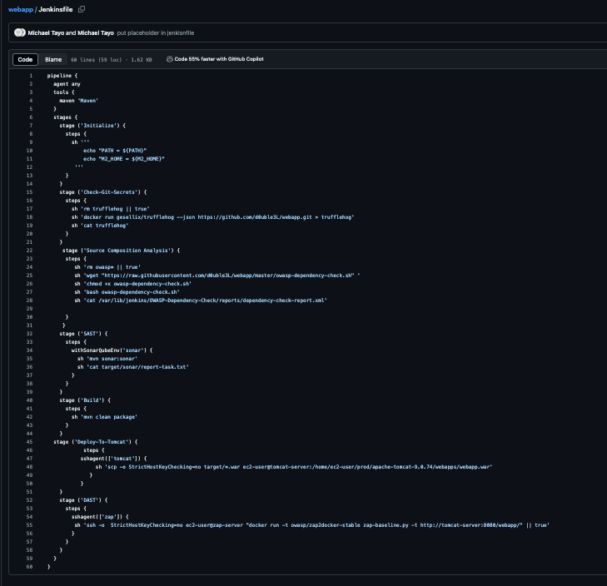
Secrets Scanning
Source Composition Analysis (SCA)
DevSecOps
Example Jenkins File
Static Analysis Security Testing (SAST)
Build
Deploy
Dynamic Analysis Security Testing (SAST)
Source: Michael Tayo (LinkedIn)
60 lines!!!!

Slide 25

Actionable Tips for Starting and Scaling DevSecOps
Implement Continuous Feedback loops
Prioritize Vulnerabilities
1
Cultural Shift
3
5
7
2
4
6
Start Small
Choose the right tools
Automate Security Checks
Monitor and Measure
Notes:
Here are some tips to start and scale DevSecOps:
Start Small: Begin with a pilot project to experiment and learn.
Cultural Shift: Promote collaboration through training.
Choose the Right Tools: Integrate tools that fit your workflow.
Continuous Feedback Loops: Establish mechanisms for improvement.
Automate Security Checks: Use CI/CD for early issue detection.
Prioritize Vulnerabilities:
Focus on high-severity issues.
Monitor and Measure: Use metrics to track effectiveness.
Educate and Empower Teams: Provide ongoing training and encourage ownership.

Slide 26




Summary
DevSecOps integrates security seamlessly into the development lifecycle, ensuring robust protection from the start.
Shift-left security, automation, collaboration, continuous monitoring, and immutable infrastructure are foundational to DevSecOps success.
Notes:
To summarize:
Comprehensive Understanding: DevSecOps integrates security throughout development.
Key Principles: Shift-left security, automation, collaboration, continuous monitoring, immutable infrastructure.
Real-World Examples: Case studies highlight successful implementations.
Benefits: Improved security, faster delivery, reduced costs, better collaboration, continuous compliance.
Actionable Steps: Start small, promote collaboration, choose appropriate tools, implement feedback loops, prioritize vulnerabilities, monitor progress, educate teams.
Call to Action: Begin your DevSecOps journey today and transform your development process.

Slide 27
Q and A
ASK AWAY!

Slide 28


THANK YOU
Michael Tayo
/michaeltayo

